Slide 1


Slide 2


Time Dilation Around a Black Hole Using Python
Second Year Project Synopsis
Submitted by
ROLL | NAME
2301010180 | Aman
2301010199 | N.Yugesh
2301010201 | Navdeep
Industry Mentor: Dr. Rishi Ranjan Kumar
Faculty Mentor: Dr. Surabhi Shanker
Notes:
New Courses replaced with New Programmes

Slide 3

Concepts and Background
What is Time Dilation?
Time dilation is a phenomenon where time appears to move slower in stronger gravitational fields.
According to Einstein's General Theory of Relativity, gravity can bend spacetime.
When you are near a very massive object, such as a black hole, time for you would pass more slowly compared to someone far away.
Simple Example: If you were standing close to a black hole, a few minutes for you could mean many years for someone on Earth.
What are Black Holes and How Time Dilation Works Around Them?
A black hole is a region in space where the gravitational pull is so strong that not even light can escape.
The boundary around a black hole is known as the "event horizon."
As you approach a black hole, the strength of the gravitational field increases enormously.
Due to this extreme gravity, time dilation becomes significant:
Closer you get to the black hole, the slower your time flows relative to someone farther away.
At the event horizon, theoretically, time would stop completely relative to an outside observer.
Notes:
New Courses replaced with New Programmes

Slide 4

Schwarzschild Metric
What is the Schwarzschild Metric?
The Schwarzschild Metric is a solution to Einstein's equations for the gravitational field around a non-rotating, spherical mass.
It helps us calculate important aspects like the event horizon and time dilation effects.
The Schwarzschild radius is a critical boundary:
It is the radius at which the escape velocity equals the speed of light.
Inside this radius, nothing can escape the black hole.
Using this metric, we derive the formulas used to calculate time dilation near a black hole.
Notes:
New Courses replaced with New Programmes

Slide 5



Mathematical Foundation (Formulas)
Schwarzschild Radius
Formula:
Explanation:
= Gravitational constant
= Mass of the black hole
= Speed of light
The Schwarzschild radius tells us the "point of no return" — if you cross this radius, you cannot escape the black hole.
We must always stay outside this radius for the calculations to be valid.
Time Dilation Factor Near a Black Hole
Formula:
Explanation:
is the distance from the centre of the black hole.
As you move closer to , the dilation factor decreases, meaning time slows down significantly.
This factor tells how much slower time runs for an observer near the black hole compared to someone far away.
Earth Equivalent Time Conversion
Formula:
Explanation:
This formula helps us convert "1 year near the black hole" to "X years on Earth."
For example, if dilation factor is 0.5, 1 year near the black hole would equal 2 years on Earth.
Essential for visualizing how drastically time behaves differently around black holes.
Note: More technical derivations and detailed physics concepts will be included in the research paper.
Notes:
Confident, clear tone) "Now, let's look at the mathematical foundation behind this phenomenon.
We use something called the Schwarzschild Metric, which solves Einstein’s equations for a spherical, non-rotating mass like a black hole.
First, we have the Schwarzschild Radius Formula:
(Show formula here.)
It involves the gravitational constant, the mass of the black hole, and the speed of light. This radius is extremely important because it defines the 'point of no return' — beyond which, escape is impossible.
Next, to measure how time dilates near a black hole, we use the Time Dilation Factor Formula:
(Show formula here.)
Here, 'r' is the distance from the center of the black hole. The closer you are to the Schwarzschild radius, the slower your time moves compared to someone far away. When r becomes equal to the Schwarzschild radius, time almost freezes!
Finally, we use a simple formula to convert time spent near the black hole into Earth time:
(Show formula here.)
For example, if the dilation factor is 0.5, then spending 1 year near the black hole would mean 2 years pass on Earth.
These formulas create the basis for our Python code and simulations."

Slide 6

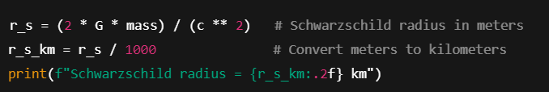
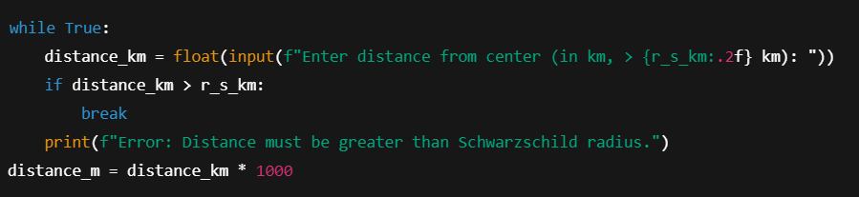
Code Execution and Output
Code Flow:
Step 1: User inputs mass (in solar masses).
Step 2: Schwarzschild radius calculated and displayed.
Step 3: User inputs distance greater than Schwarzschild radius.
Notes:
New Courses replaced with New Programmes

Slide 7


Step 4: Time dilation factor calculated
Step 5: Earth time equivalent derived

Slide 8
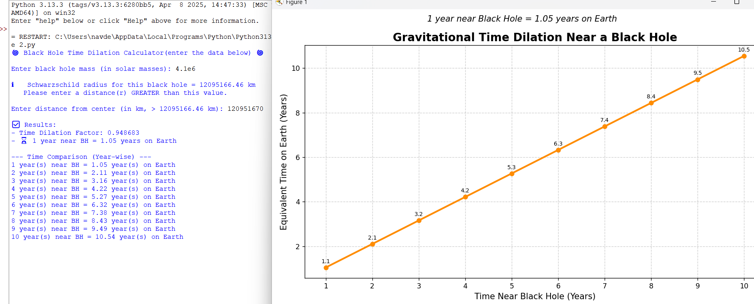
Results obtained ( Mathematical Calculations and Graphs)

Slide 9
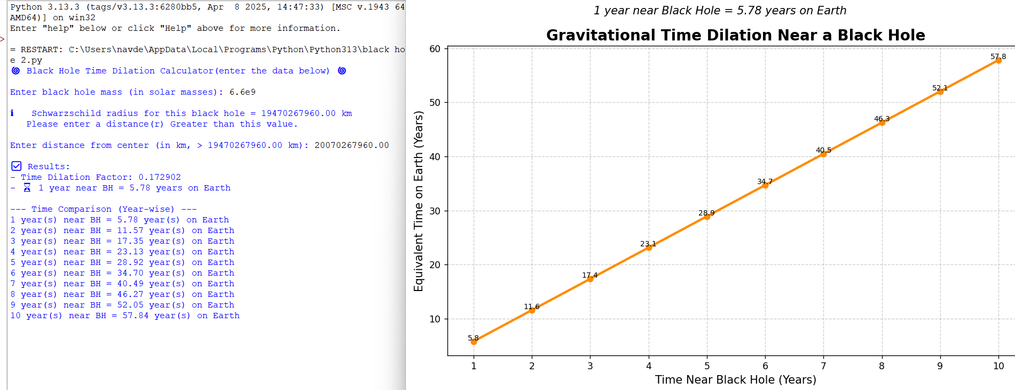

Slide 10
THANK YOU

